Slide 1
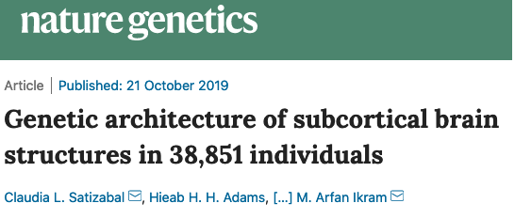

Danny Antaki
Gleeson Lab Meeting
02/07/2020

Slide 2
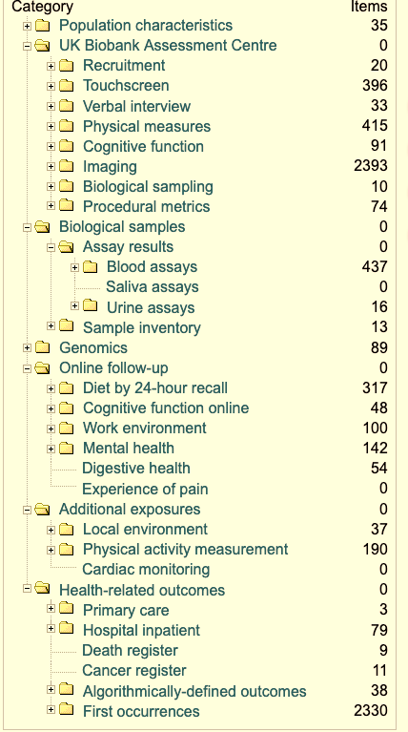
How does genetics and environment contribute to disease?
UK biobank (UKBB) enrolled ~500,000 members
Genotypes, Exomes
Ages 40-69; diseases of middle age
Phenotypes
NHS medical records (diagnoses, hospitalizations, etc.)
CBCs & urinalysis
Medical imaging (retina, brain MRI)
Measurable phenotypes (weight, height)
Behavior, Cognition, Psychiatric conditions
Location, environment, exposure
And more…
UKBB Available Phenotypes

Slide 3

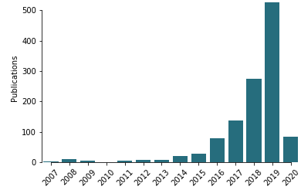
UKBB is realizing the promise of genomics
Genome Wide Association Studies (GWAS) was thought to solve all disease in the early 2000s
Most GWAS suffered with small sample sizes (100s or 1000s)
No replication (Autism)
Too many hits (Height)
“UK Biobank” publications in PubMed

Slide 4
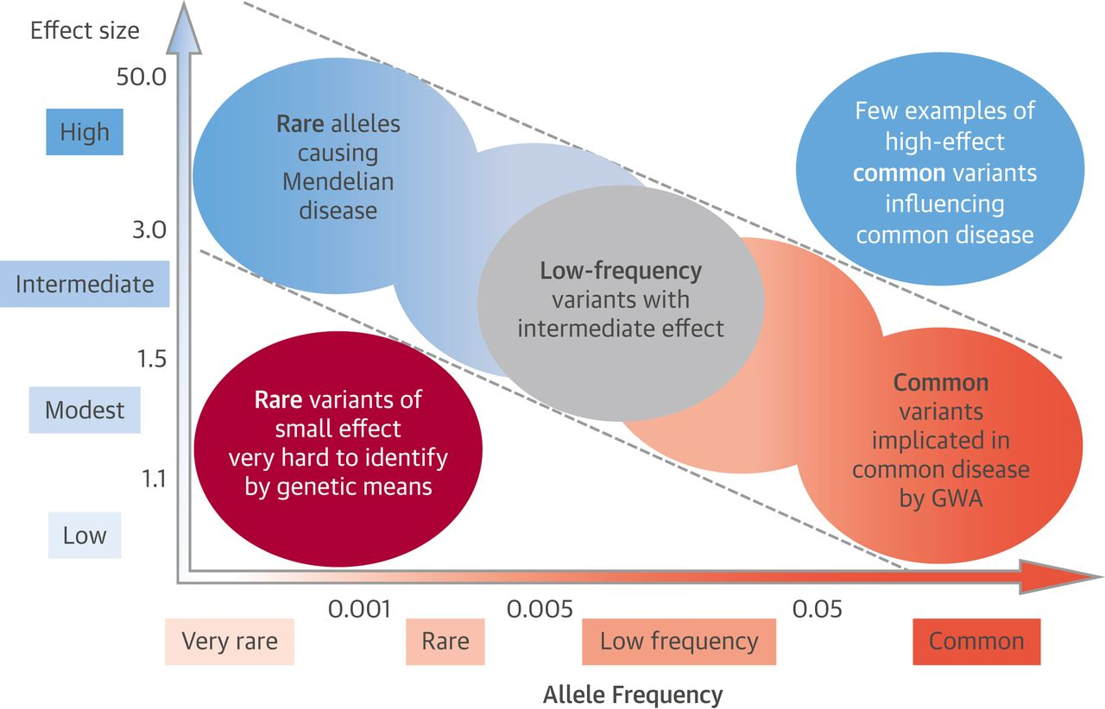
UKBB is poised to discover genetic causes of common disorders
UKBB real strength is with common variants
currently
Exomes and genomes will fill in the gaps
This study and other GWAS
Potential with Exomes and Genomes

Slide 5
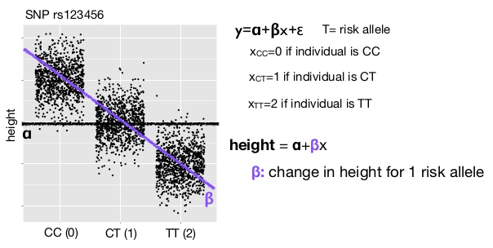
GWAS for Quantitative Traits Use Linear Regression
This study and others implement an additive model
The effect of the “risk” allele is positively correlated to the dosage
The slope of the line of best fit determines the strength of the effect
Perform a linear regression genome-wide
10k-100k statistical tests
Classic p-value threshold = 5x10⁻⁸

Slide 6
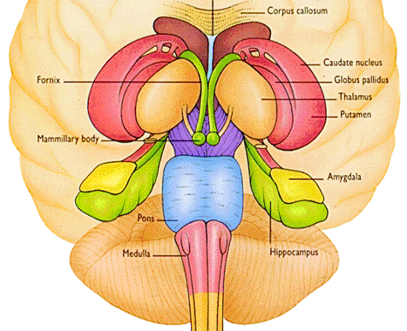
The subcortical brain is essential for the control of autonomic and sensorimotor functions
Regulates unconscious bodily functions
Heart rate, digestion, respiration etc.
Other functions:
Learning
Memory
Decision-making
Emotional reactivity
Consciousness

Slide 7
Cognitive, Psychiatric and Motor Disorders Affect the Subcortical Brain (SB)
Many models posit these disorders begin in the SB
ASD
Schizophrenia
OCD
SB implicated in neurodegenerative disorders
Alzheimer’s
Parkinson’s
Heritability of these disorders is significant

Slide 8
SB Volume Is Controlled by Neurodevelopment and Learning Genes
Two previous studies associated common variants to SB volume
CHARGE: Cohorts of Heart and Aging Research in Genomic Epidemiology
ENIGMA: Enhancing Neuro Imaging Genetics through Meta-Analysis
This study combined CHARGE and ENIGMA with UKBB
28,809-37,741 total samples
increased power to identify additional novel variants
improve our understanding of brain devel- opment and disease
SNPs associated with the size of the crossing pontine tract. Elliot et al. 2018 Nature.

Slide 9
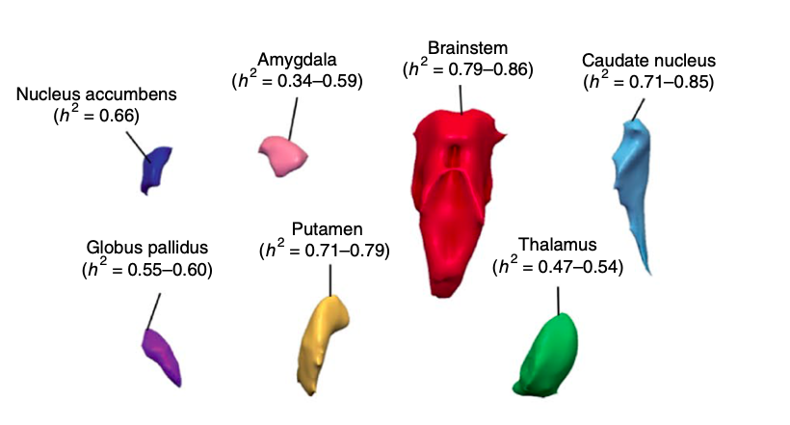
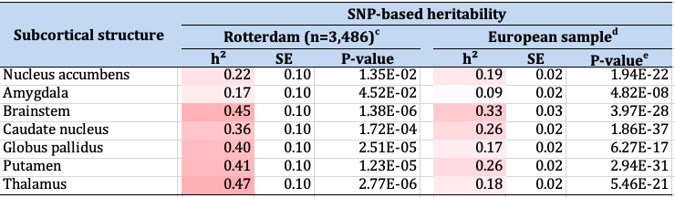
SB Volume is a heritable trait
Family based estimates of heritability
Range from 0.34-0.86
SNP based estimates are lower
Goal of the study is to identify the genomic regions contributing to SB size

Slide 10
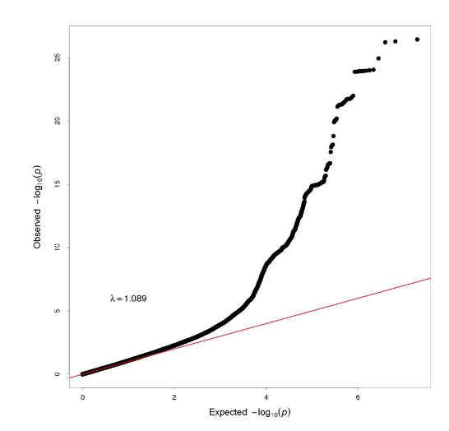
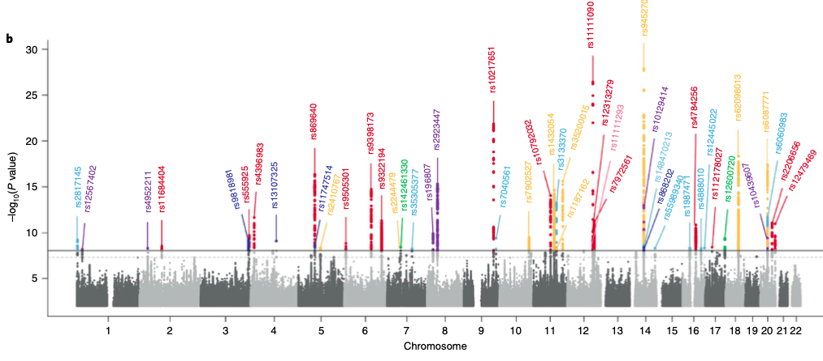
48 independent loci contribute to SB size
40 are novel
26 are in genes
1 missense
Notes:
Did this in Europeans but when they took the the top SNPs in AA and Asians they saw the effects were mostly polygenic

Slide 11
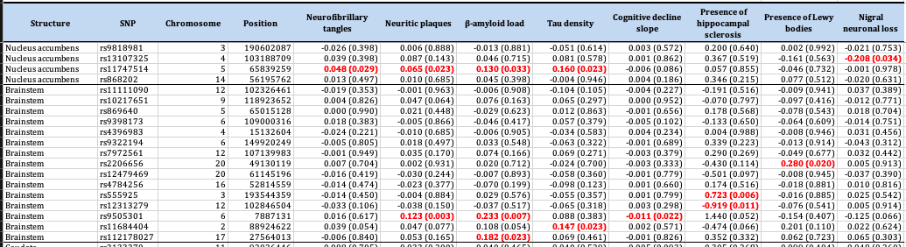
Index SNPs in LD to eQTL and mQTL identified 199 candidate genes
DLG2, FOXO3, IGF1, MEF2C, PPIL4…
Nominal associations of postmortem SB to neurodegeneration pathology
Cortical mRNA expression in Alzhiemer’s brain associated with 12 candidate genes

Slide 12
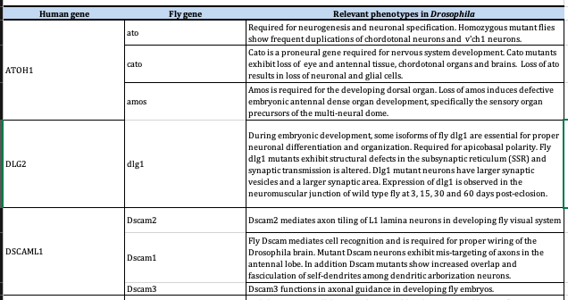
59% of candidate genes conserved in Drosophila
Development of the CNS is strongly conserved
Similar genetic regulators
Some were associated with “neuroanatomy-defective phenotypes”

Slide 13
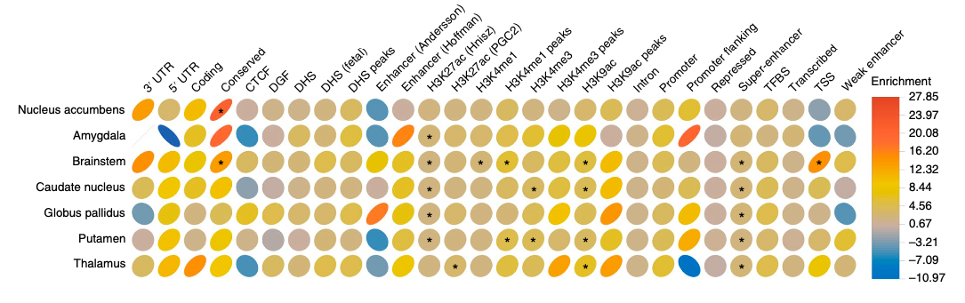
Genomic Loci Implicated in SB Size have Noncoding Regulatory Function
Method groups SNPs in functions categories (columns) and estimates the heritability
Enrichment = heritability / proportion of SNPs in functional categories
Heritability explained is of low-effect

Slide 14
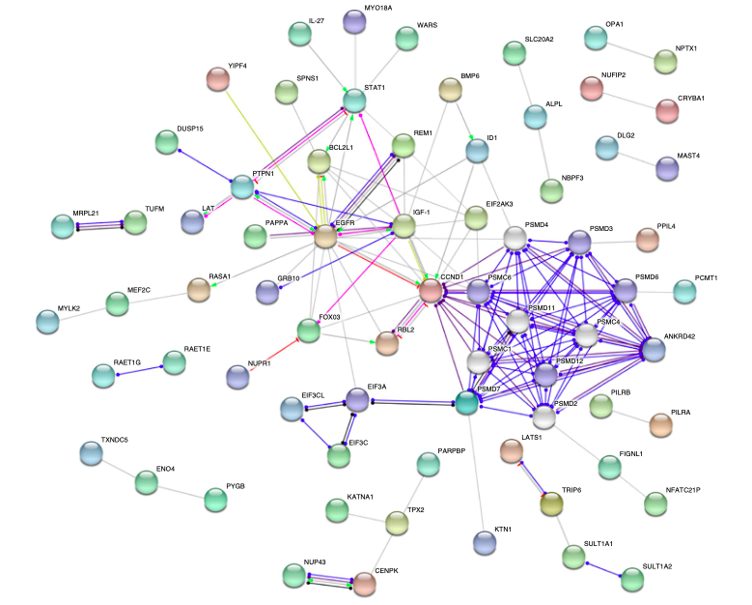
Protein-Protein Interactions Enriched in Neuronal Apoptosis Pathways

Slide 15
Many of the Candidate Genes are Implicated in Neurological Disorders
PTPN1 (protein-tyrosine phosphatase 1B)
is a regulator of neural differentiation.
target for MECP2 (Rett Syndrome)
ALPL (Alkaline Phosphatase) involved with tau neurotoxicity
Alzheimer’s
MAST4
(Microtubule Associated Serine/Threonine Kinase Family Member 4)
juvenile myoclonic epilepsy

Slide 16
How can we apply UKBB?
Heterozygous carriers of recessive alleles
Test for intermediate phenotype
Neurological Phenotypes
Cognition
Memory
Common Psychiatric
Omnigenic = Polygenic + Rare Variant burden

Slide 17
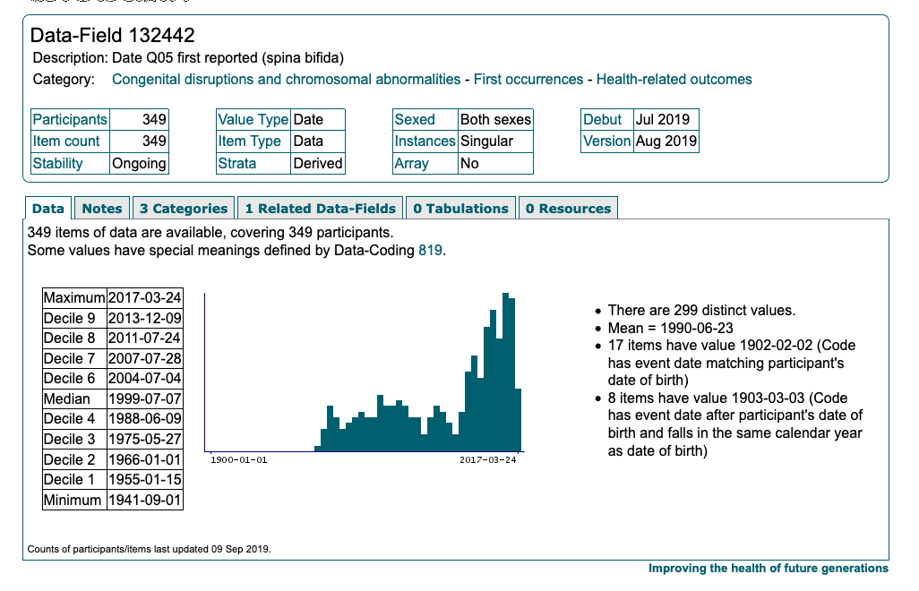

Slide 18
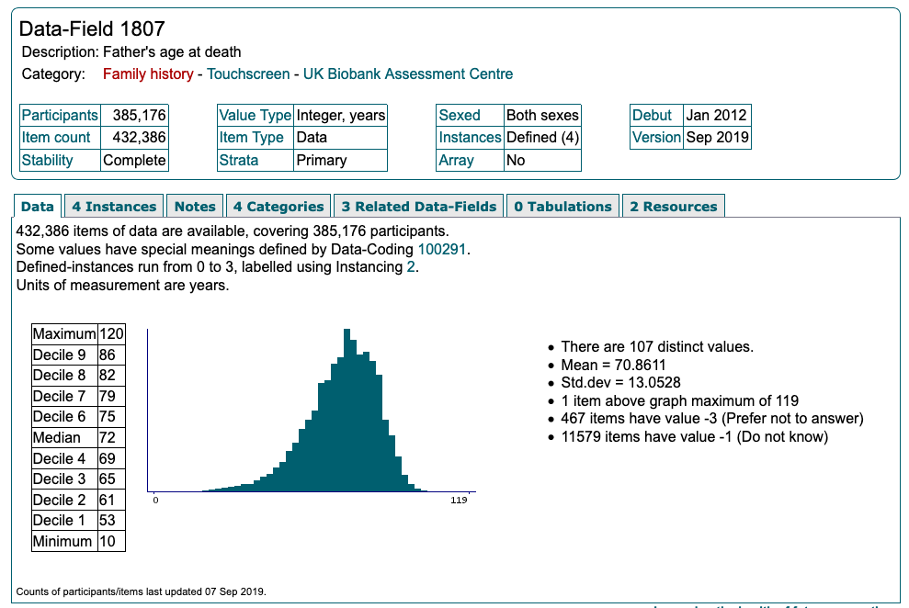

Slide 19
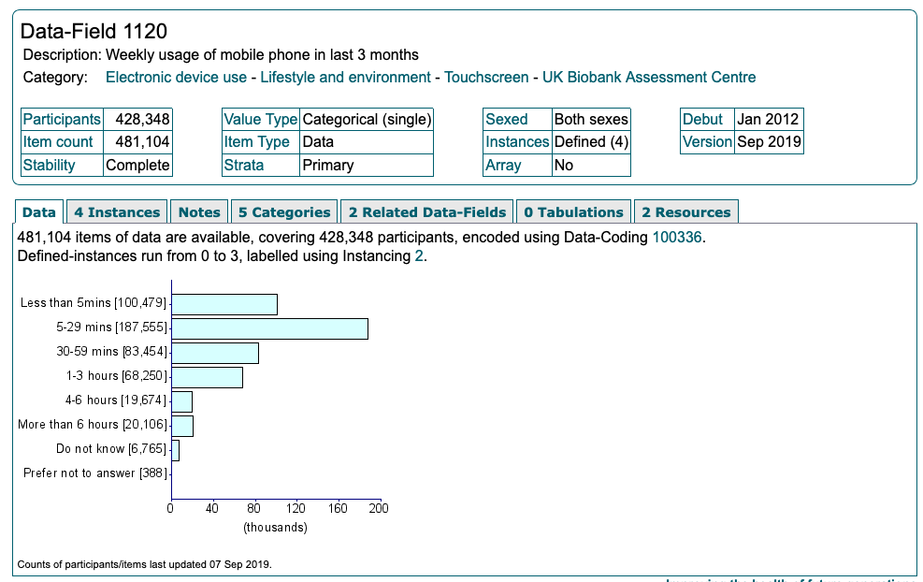

Slide 20
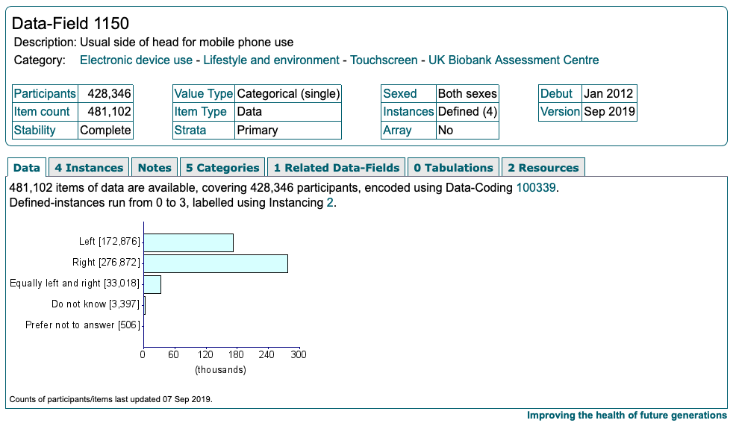

Slide 21
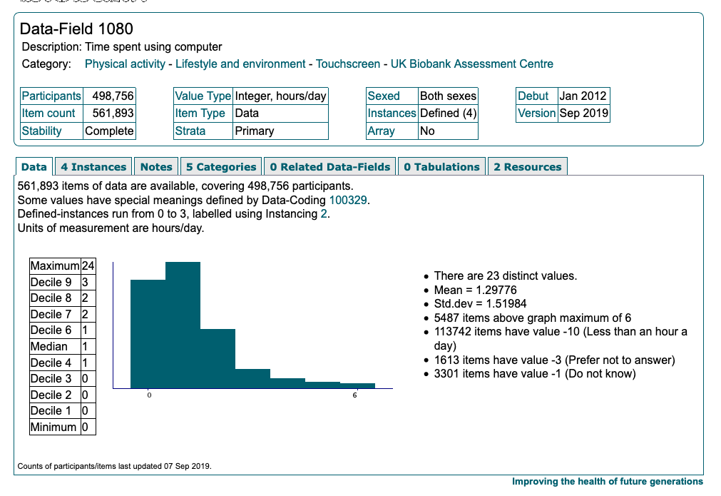

Slide 22
